Slide 1
Appendix 2 Concept of objects and object-oriented software

Slide 2
前言
It is difficult to use objects correctly without understanding why the object-oriented paradigm is superior to the structured paradigm.
介紹 class/ object 的導入背景、 class/ object的特性、及 object-oriented software的特性
由 module 談起

Slide 3
What is a Module? (1 of 3)
Monolithic block of code → difficult to maintain
Hardware system experience
  Compare Fig. 6.2 and Fig. 6.3, Fig. 6.2(硬體模組) is easier to understand, locate fault, reuse and extend than Fig. 6.3. (模組化的好處)
  模組設計的準則: Maximal relationships within modules, minimal relationships between modules
Can software product be designed like Fig. 6.2?

Slide 4
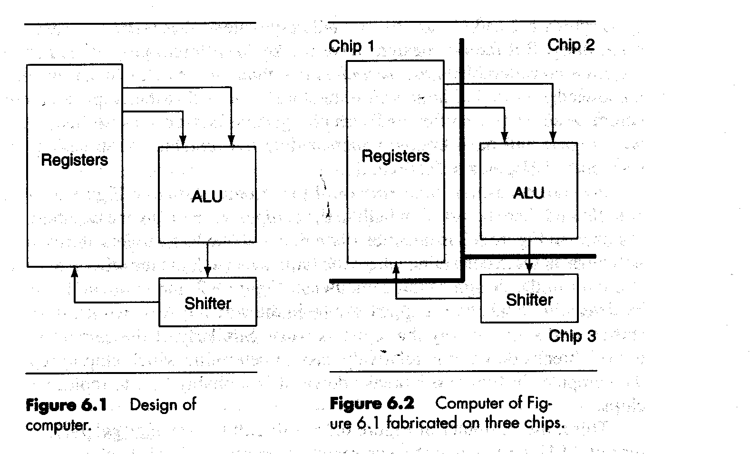

Slide 5
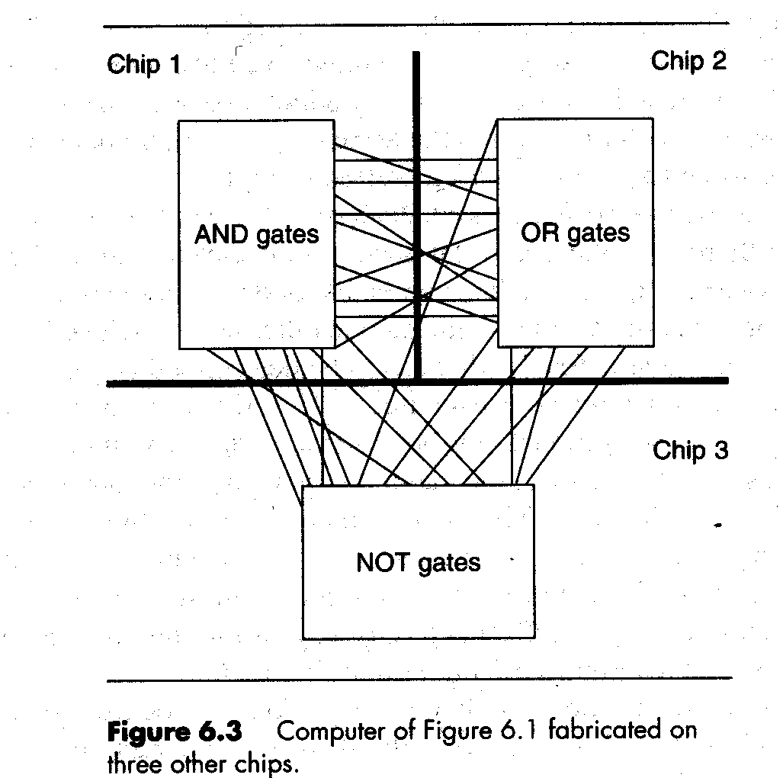

Slide 6
What is a Module? (2 of 3)
Module [Stevens, Myers, and Constantine]:
  A set of one or more contiguous program statements have a name by which other parts of the system can invoke it, and preferably having its own distinct set of variable names.
  It includes procedures and functions of all kinds, whether internal or separately compiled.
  A lexically contiguous sequence of program statements, bounded by boundary elements, having an aggregate identifier. [ Yourdon and Constantine]

Slide 7
What is a Module? (3 of 3)
If the product is designed by modules, how to quantify the modules designed?
  Cohesion (strength): The degree of interaction within a module (模組內程式碼間的結合度)
  Coupling (binding): The degree of interaction between two modules.(模組間的關連度)
The action of a module is what it does (i.e. its behavior).
The context of a module is the specific usage of that module.
The name assigned to a module is its action and not its logic or its context.
Example
  Module computes square root of double precision integers using Newton’s algorithm. Module is named compute square root

Slide 8
功能1
功能1
功能2
.
模組示意圖
.
.
功能n

Slide 9
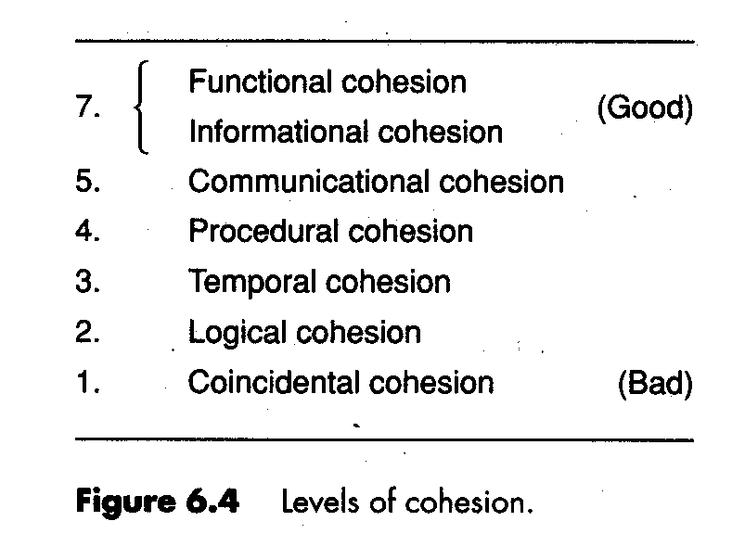
Degree of Cohesion (1 of 6)

Slide 10
Degree of Cohesion (2 of 6)
Coincidental cohesion
  A module has coincidental cohesion if it performs multiple completely unrelated actions.
  Drawbacks: difficult to maintain and understand, lack of reusability
Logical cohesion
  A module has logical cohesion when it performs s series of related actions, one of which is selected by the calling module ( actions 間之相似度高)
  Example
  Drawbacks: Interface is difficult to understand. Difficult to maintain (e.g. a new tape unit is installed)

Slide 11
Example: Module new operation which is invoked as follows:
function code =7;
new operation (function code, dummy 1, dummy 2, dummy3);
//dummy1, dummy2, and dummy 3 are dummy variables,
//not used if function code is equal to 7
// module performing all input and output
1. Code for all input and output
2. code for input only
3. code for output only
4. code for disk and tape I/O
5. code for disk I/O
6. code for tape I/O
7. code for disk input
…

Slide 12
Degree of Cohesion (3 of 6)
Temporal cohesion
  A module has temporal cohesion when it performs a series of actions related in time.
  Example: system initialization
    open old master file, new master file, transaction file, and print file,
    initialize sales district table,
    read first transaction record,
    read first old master record
  The actions of the module are weakly related to one another, but more strongly related to actions in other modules.
  Difficult to reuse.

Slide 13
Degree of Cohesion (4 of 6)
Procedural cohesion
  A module has procedural cohesion when it performs a series of actions related by the sequences to be followed by the product.
  Example: read part number from database, update repair record on maintenance file
  Drawback: actions are weakly connected. Not easy to reuse

Slide 14
Degree of Cohesion (5 of 6)
Communication cohesion (flowchart cohesion)
  A module has communication cohesion when it performs a series of actions related by the sequences to be followed by the product and if all the actions are performed on the same data.
  Example: update record in database and write it to the audit trail.
  Drawback: too specific, not easy to reuse.
Informational Cohesion
  A module has informational cohesion if it performs a number of actions, each with its own entry point, with independent code for each action, all performed on the same data structure.

Slide 15
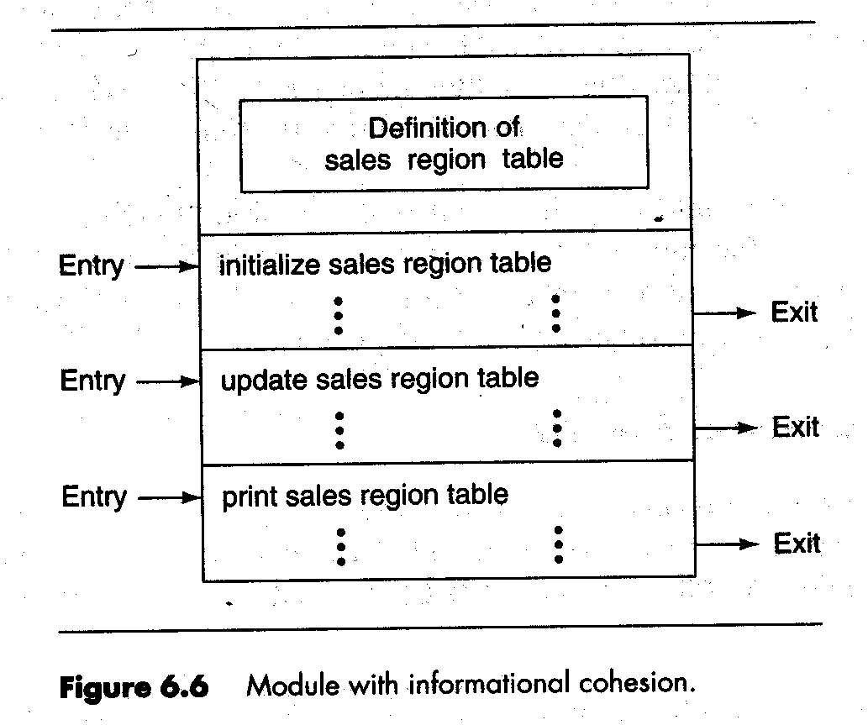

Slide 16
Degree of Cohesion (6 of 6)
Functional cohesion
  A module that performs exactly one action or achieves a single goal has functional cohesion.
  Example; compute trajectory of missile, write to disk
  Easy to maintain, understand, extend, reuse.
模組內的 codes 最好是為執行共同功能目的或共用相同資料結構而結合

Slide 17
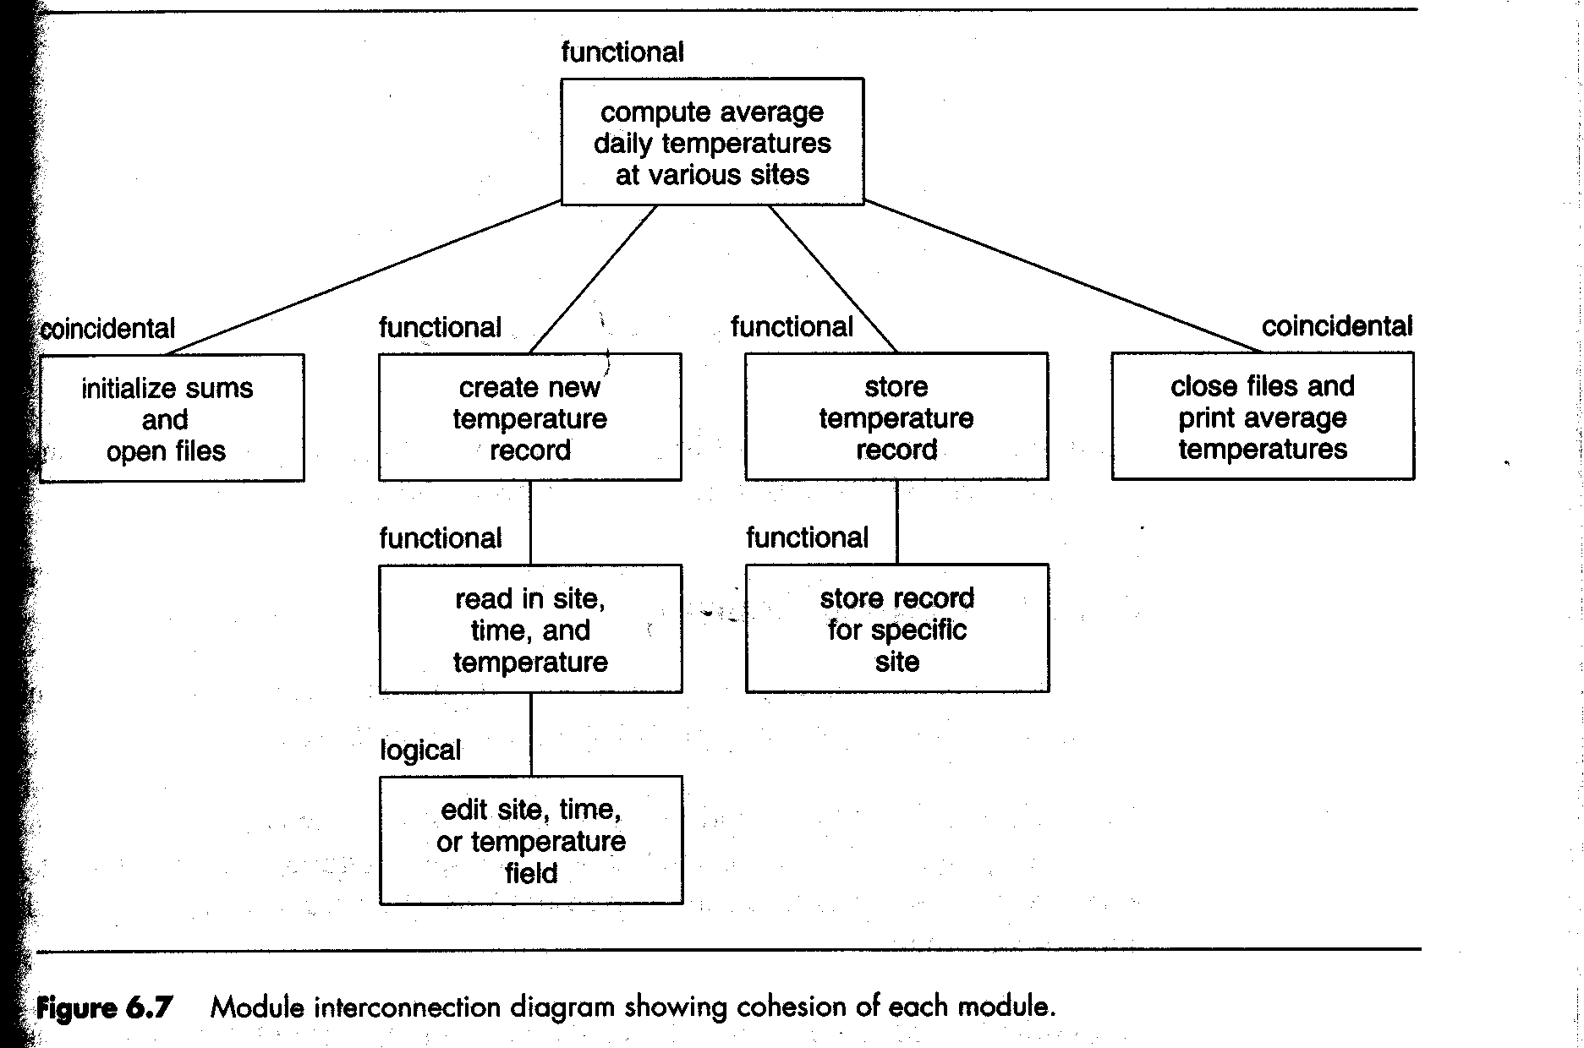

Slide 18
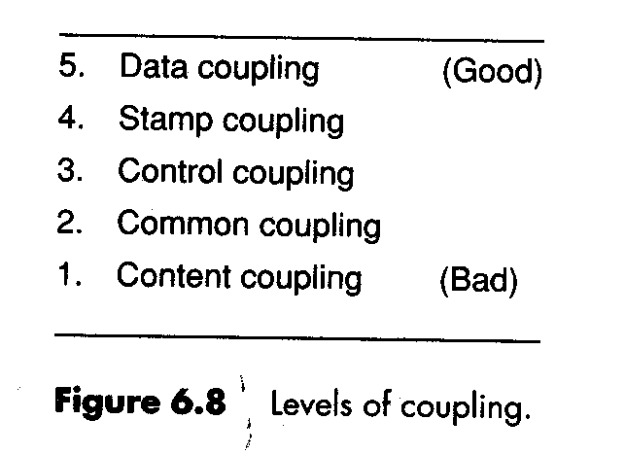
Degree of Coupling (1 of 4)
Content coupling:
Two modules are context coupled if one directly references the contents of the other.
  Example: Module p modifies a statement of module q. module p branches to a local label of module q.
  Drawback: Any change to q requires change to p.

Slide 19
Degree of Coupling (2 of 4)
Common coupling
  Two modules are common coupling if they both access to the same global data.
  Drawbacks: (1)Code is virtually unreadable. (2)Modules have side effect that affect their readability. (3)When the declaration of a global variable in one module is changed, then every modules access this global variable should be changed too. (4)difficult to reuse. (5) more danger to generate error.

Slide 20
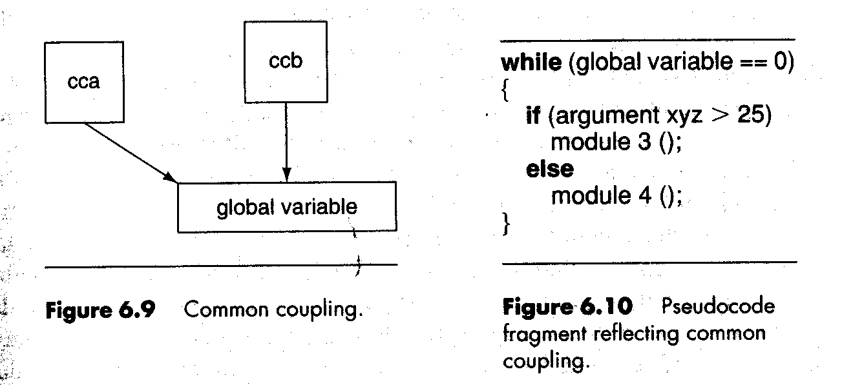

Slide 21
Degree of Coupling (3 of 4)
CONTROL COUPLING
  Two modules are control coupled if one passes an element of control to the other module, that is one module explicitly controls the logic of the other.
  Drawback: Two modules are not independent.
Stamp coupling
  Two modules are stamp coupled if a data structure is passed as an argument, but the called module operates on only some of the individual components of that data structure.
  Drawback: 部份 argument 資料沒用到→Difficult to understand, unlikely to be reusable

Slide 22
Degree of Coupling (4 of 4)
Data coupling
  Two modules are data coupled if all arguments are homogeneous data items (i.e. simple arguments or data structures in which all elements are used by the called module.
Example of coupling -- Fig. 6.11
Coupling dependency metric
  CDM(A): measure the change of module A when the product is changed.
  CDM is a excellent metric for predicting run-time faults.
All Modules of a good design should have high cohesion and low coupling.

Slide 23
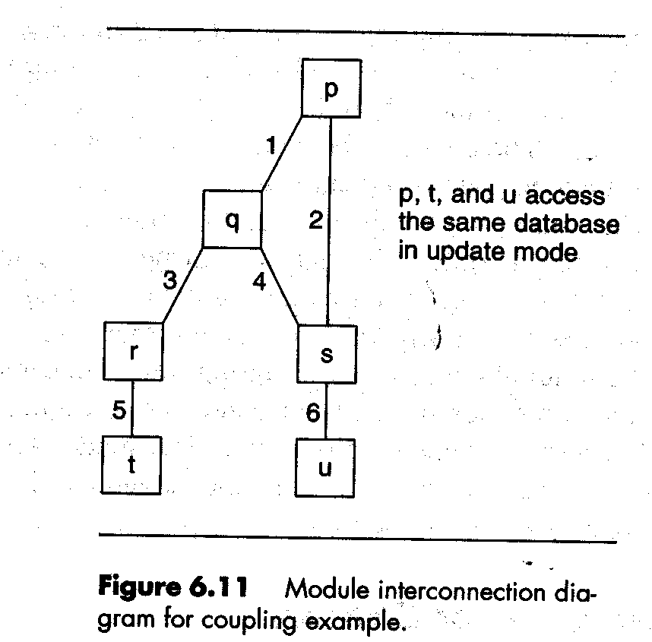

Slide 24
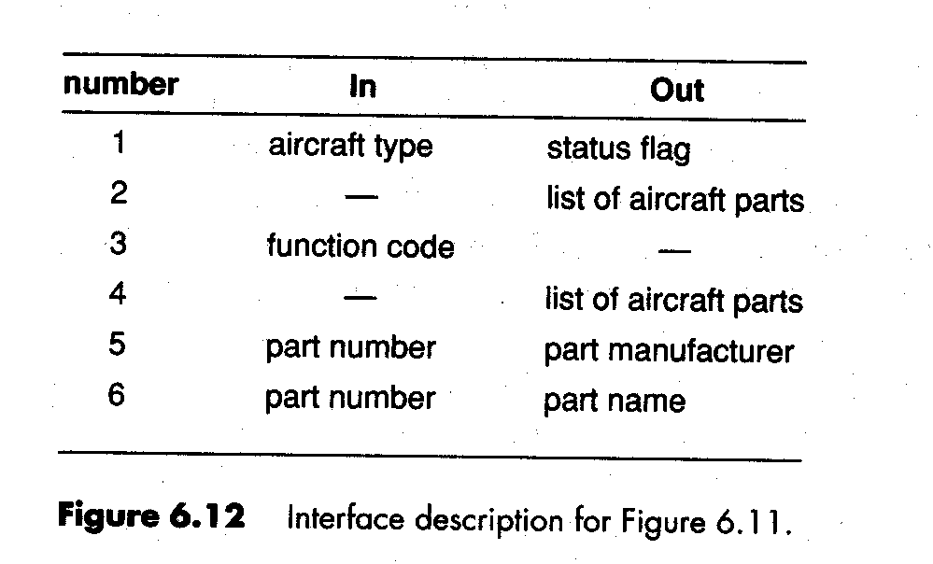

Slide 25
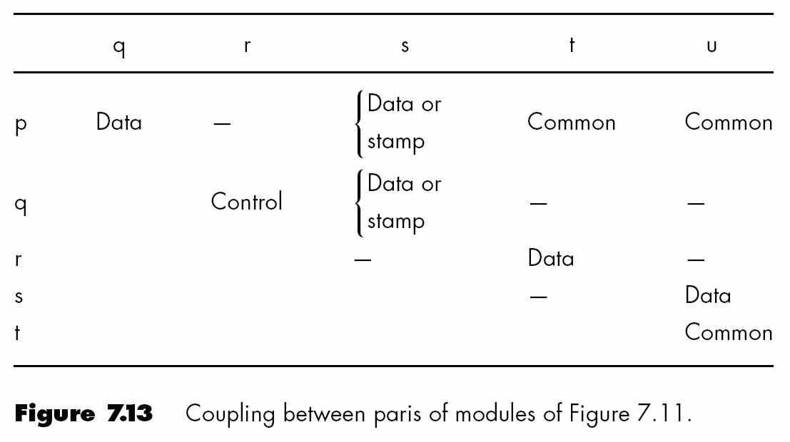

Slide 26
Concept of Data encapsulation (1 of 2)
Example: design of job queue
  Fig. 6.15 →Actions on the job queue are spread all over the product. → low cohesion
  Fig.6. 16 → actions on the same data structure, each action has its own entry point , exit point, and independent code. → data encapsulation
Data encapsulation: Data structure (job_queue) together with operations performed on that data structure (An example of abstraction)
  Abstraction leads stepwise refinement in software design
  High-level design (inter-component level) → low level design (component level) {conceptualize problem at a high level}
  Data abstraction and procedural abstraction
Level of abstraction of a computer

Slide 27
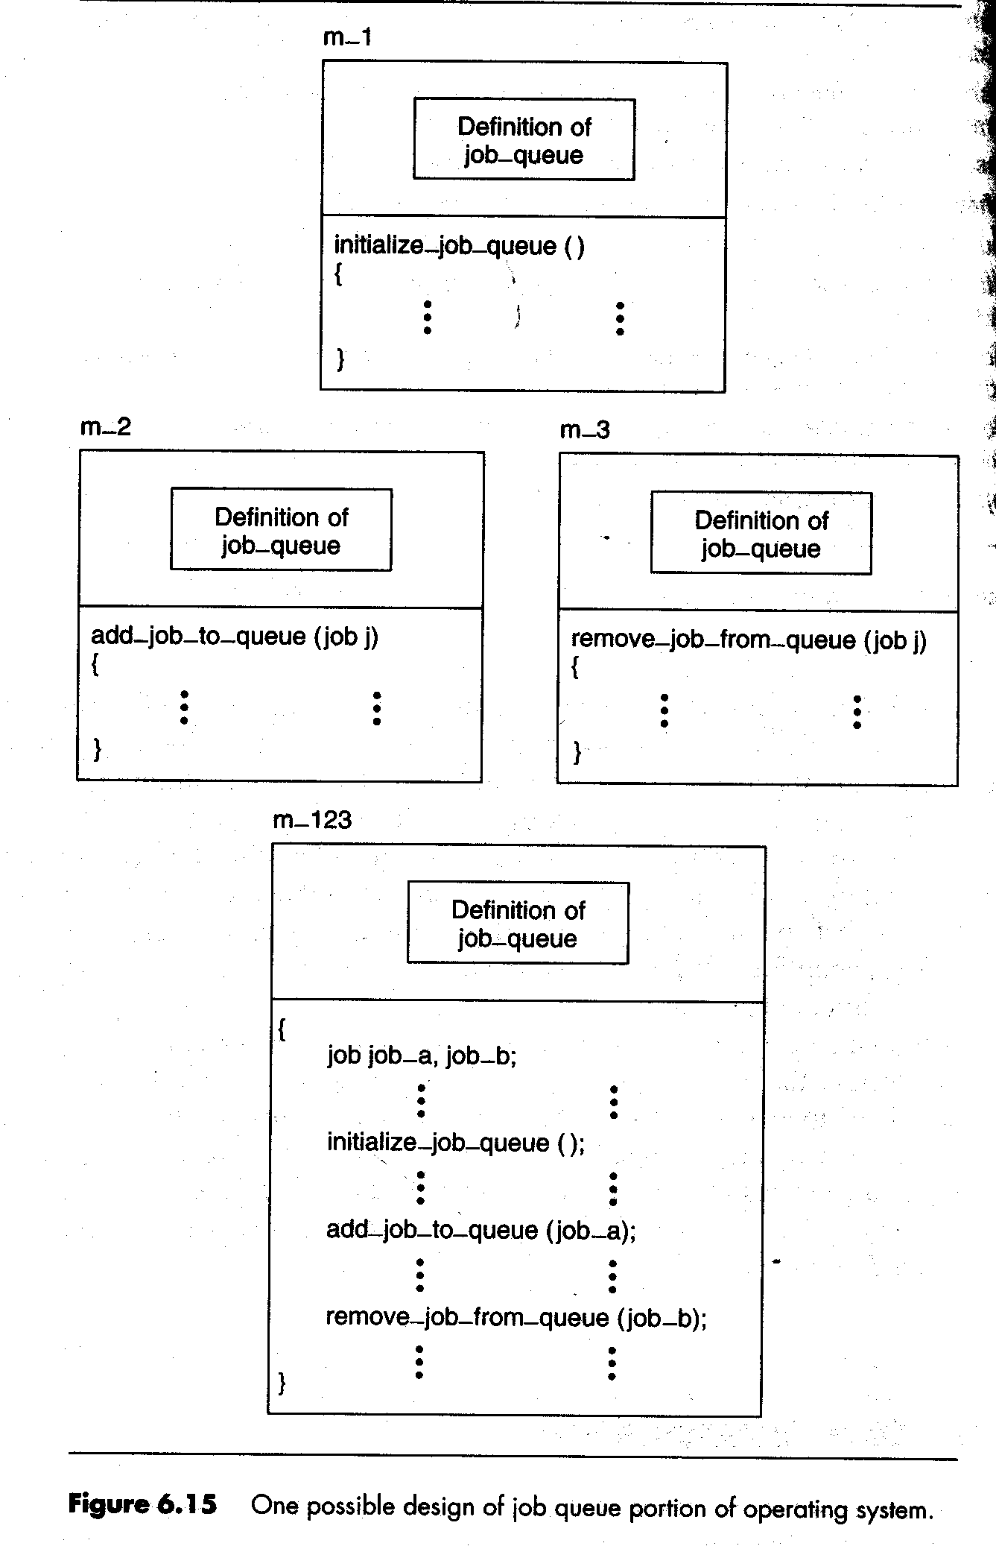
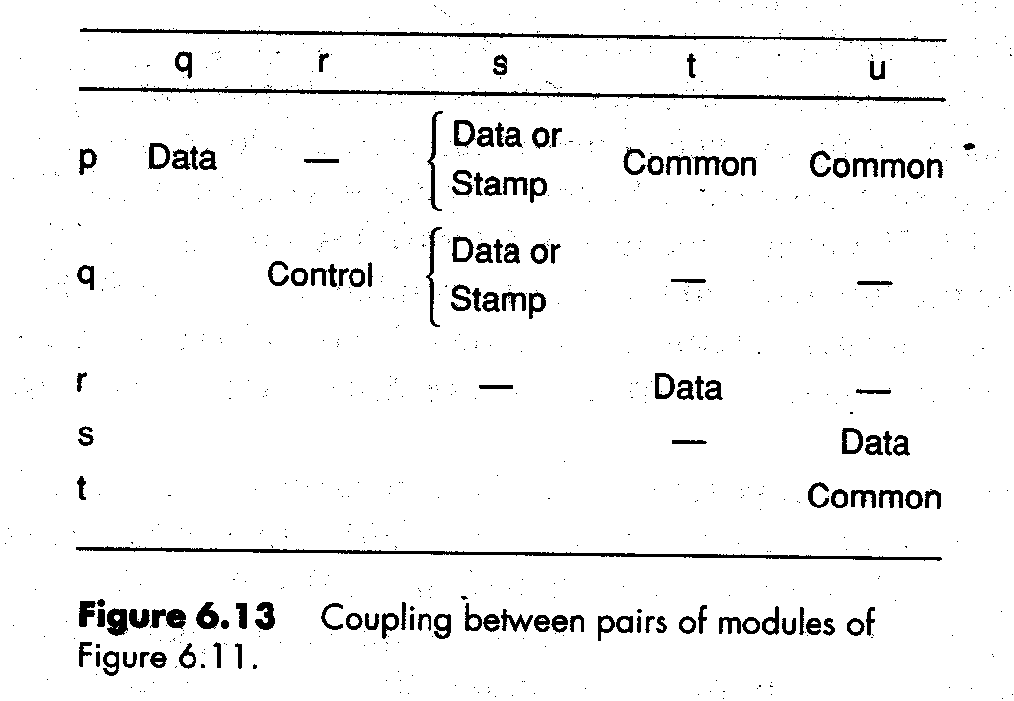

Slide 28
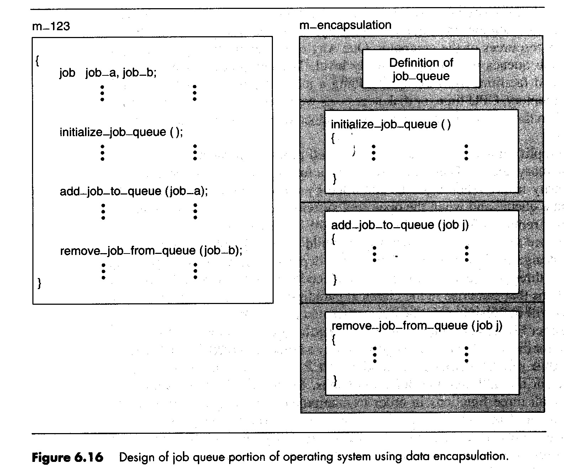

Slide 29
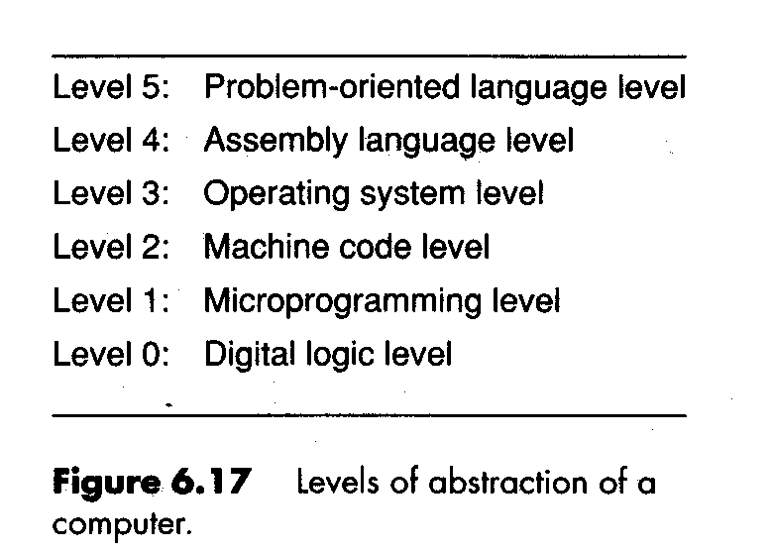

Slide 30
Concept of Data encapsulation (2 of 2)
先定義資料結構名稱及相關 operation signature,再談設計 → minimize the effects of future change of the product.
Example: Fig. 6.18
  Queue: linear list → doubly linked list
  Without change specification → other parts of the product should not be changed.
  Simplify product maintenance and reduce the chance of a regression fault.
Abstract data types – 新定義!
  定義資料結構名稱及其使用方式,看不到內部結構!
  support both data abstraction and procedural abstraction

Slide 31
//warning
// This code has been written in such a way to be accessible to readers
// who are not Java experts,as opposed to using good Java style.Also,vital
//features such as checks for overflow and underflow have been omitted
//
class JobQueue
//instance variables
public int queueLength; //length of job queue
publis int queue[]=new int[25]; // queue can contain up to 25 jobs
// methods
public void initializeJobQueue()
/*
*emptyjob queue has length 0
*/
{
queueLength=0;
}

Slide 32
public void addJobToQueue(int jobNumber)
/*
*add job to end of job queue
*/
queue[queueLength]=jobNumber;
queueLength=queueLength+1;
}

Slide 33
public void removeJobFromQueue(int jobNumber)
/* set jobNumber equal to the number of the job stored at the head of the queue,
*remove the job at the head of the job queue, and move up the remaining jobs
*/
{
jobNumber=queue[0l;
queueLength=queueLength-1;
for (int k=0; k< queueLength; k++)
queue[k]=queue[k+1];
}
}//class job queue
Fig. 6.18 Java implementation of class jobQueue

Slide 34
Information Hiding
Abstract data types 的好處:使用者只看到模組外部界面, 且code 與 data 分開
information hiding
  Design the modules in a way that items likely to change are hidden
  Future change is localized
  Changes cannot affect other modules
Data abstraction
  Designer thinks at level of an ADT
Procedural abstraction
  Define a procedure—extend the language
Effect of information hiding via private attributes

Slide 35
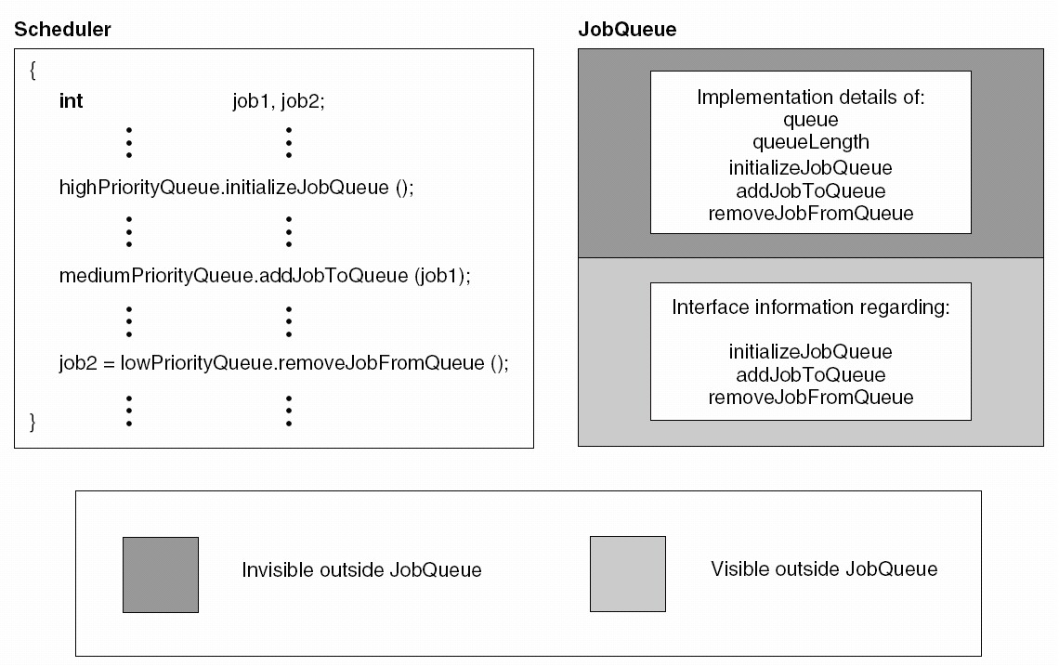

Slide 36
Objects/Classes (1 of 3)
First refinement – 延伸 ADT 以設計軟體
  Product is designed in terms of abstract data types
  Variables (“objects”) are instantiations of abstract data types -- objects有各自 data area ,但共用 procedures codes
Second refinement 定義 class 及延伸 code sharing
  Class: abstract data type that supports inheritance
  Objects are instantiations of classes
Example :Define humanBeing to be a class
  A humanBeing has attributes, such as age, height, gender (定義資料區)
  Assign values to attributes when describing object

Slide 37
Objects /Classes (2 of 3)
An instance is an object created from a class, the behavior and information structure of the instance are defined by its class.
A class is sometimes called the object’s type.
A class is an abstraction that describes all the common characteristics of several objects: objects of the same class have the same definition both for their operations and for their information structures.
Each instance has a unique identity.

Slide 38
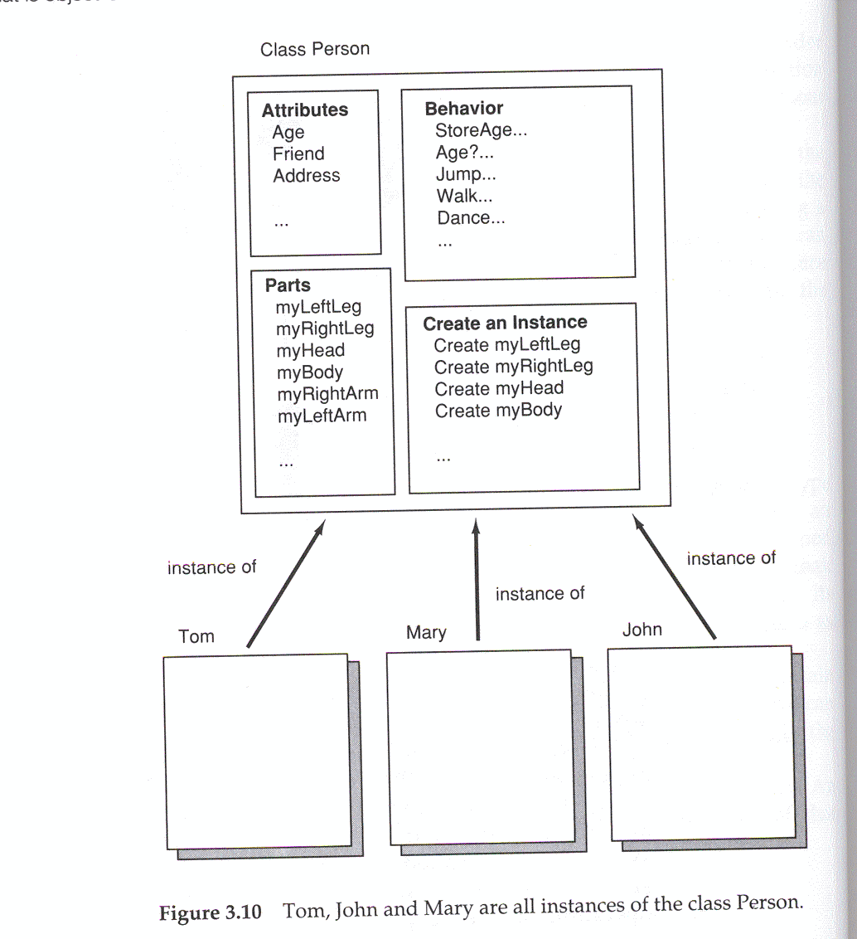

Slide 39
class
object
New() : code to generate data area and link to the operations
Pointer to method 1
Pointer to method 2
Method1() code
Pointer to method N
Method 2() code
Data area for attributes
Method N() code

Slide 40
Objects /Classes (3 of 3)
An object is a concrete entity that exists in time and space; a class represents an abstraction, the essence of an object.
Object:
    An element in a running program.
    Object is an entity, of the system, able to save state (information, represented by attributes) and offers a number of operations (behavior) to examine or affect this state.
    Some operations may not affect any internal information of the object, but only perform a behavior.

Slide 41
Inheritance of Classes
Inheritance -- an essential feature of object-oriented languages
  擴大 code sharing 的使用,定義 subclass
  Define Parent to be a subclass of HumanBeing
    A Parent has all attributes and operations of a HumanBeing, plus attributes and operations of his/her own (name of oldest child, number of children)
  可修改部份 attributes及 operations – overriding的觀念
  Generalization/specialization relationship

Slide 42
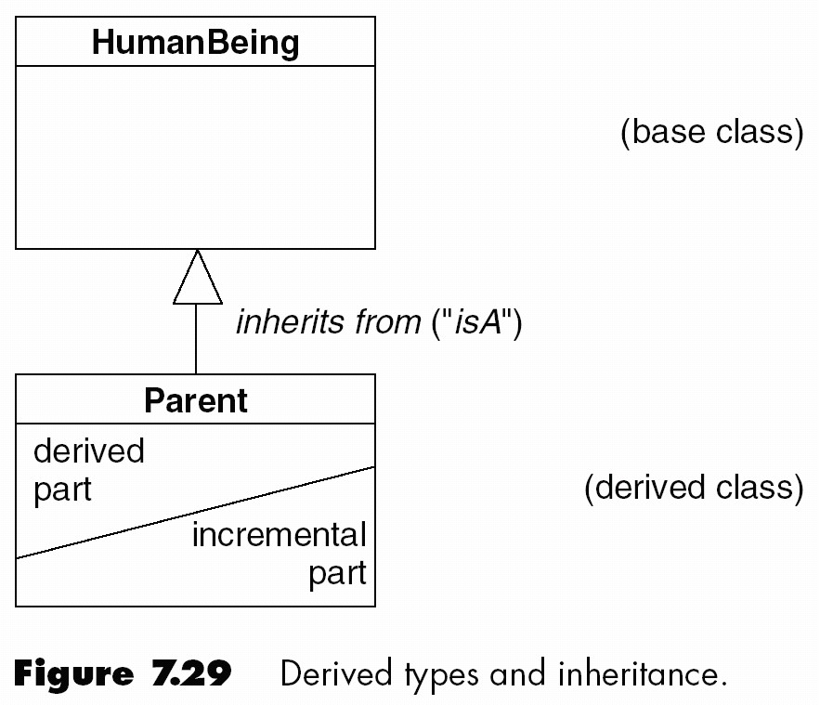
UML notation
  Inheritance is represented by a large open triangle

Slide 43
Aggregation -- Classes 組成關係
Aggregation – 一個 class 由多個 classes組合而成 (Whole-part relation)
  “consist-of” (結合体) relation: parent object 去除時,child objects不能存在
  “join-together” (組合体) relation: parent object 去除時,child objects可繼續存在
一個 class的 attributes 為其他 objects,且有自己的 methods,這些methods可呼叫其他內部objects的methods

Slide 44
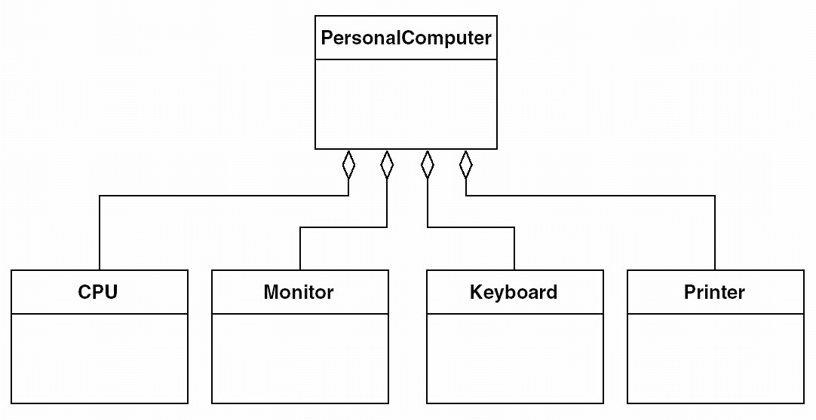
Aggregation

Slide 45
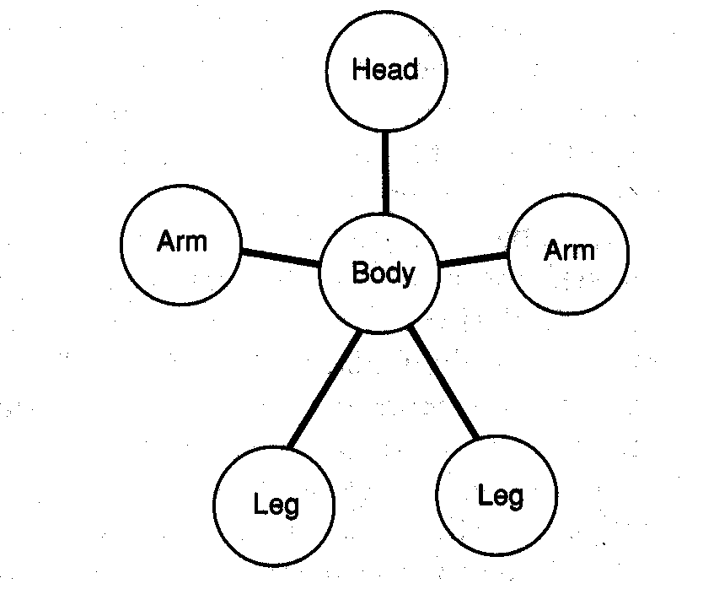
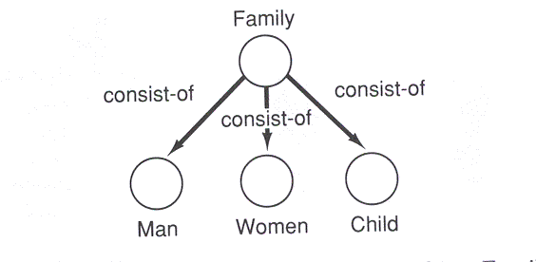

Slide 46
Dependency relation of classes
Whole-class and part- class之間關係
  part- class內method作修改，影響呼叫此method之whole- class method之執行行為
一class A 修改時將影響另一class Ｂ之執行行為，則class Ｂdepends on class A.
  例如method之參數為object, class之attribute為object，等等

Slide 47
Association -- Classes 間的關係
A system consists of a set of elements which are interacted to perform a specified task to meet the user’s goal.
從程式結構觀點，class是物件導向軟體系統的基本element，執行時element (object/class)間應有交互行為(interaction) →Association: class間有inheritance、 dependency、與aggregation 以外的關係

Slide 48
Class 與object的關係
Object-oriented program執行時,在某一時刻看到物件間關係
Object-oriented program內，class 與object的對應關係
  Object皆有對應的class,且多個Object可對應同一個class
在 object diagram 中
  Inheritance relation沒有意義
  Dependency relation代表object A 的行為受object B影嚮
  Aggregation relation代表物件間包含關係

Slide 49
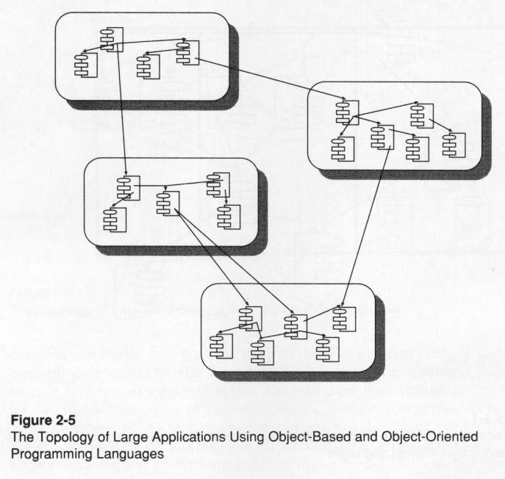

Slide 50
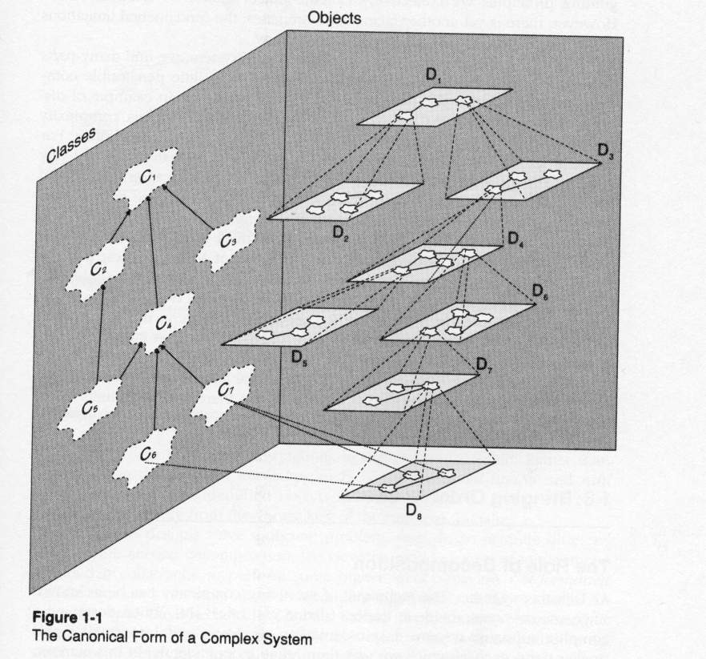

Slide 51
Dynamic relations of objects (1 of 4)
物件間若無交亙行為,則仍為獨立個體而無法構成完整程式之功能→一 object A 的 method X執行時可呼叫另一object B的 method Y執行, method Y執行完成時將返回method X
Two objects may communicate with each other via message passing.
The dynamics in an object model are create through dynamic relations, by means of objects sending stimuli (event or message) to other objects.

Slide 52
Dynamic relations of objects (2 of 4)
Stimulus indicates that it stimulates some behavior to take action and does not necessarily include any message information.
A stimulus, received by an object, causes an operation to be performed in the receiving object. When the operation is finished, it returns the result to the caller
An object may create or destroy another object.

Slide 53
Dynamic relations of objects (3 of 4)
An object may request to create another thread to execute another (active) object concurrently.
Active object: an object can be executed by another thread
  此 object 有一method為run( )
  當此 object 的start ( ) 被呼叫時,則啟動另一 thread 執行此 object的run( ) method,原thread 繼續執行( parallel operation
Active object所屬的class,稱為 Active class

Slide 54
Dynamic relations of objects (4 of 4)
Two parallel executions will have some interaction (data exchange)
  一 thread 執行時呼叫另一 active object 的非run( ) 的method
  Invoke different methods of same object
Shared object: an object invoked by the objects of two or more different threads
Shared object所屬的class,稱為 Shared class
  Synchronization issue

Slide 55
Interface and Abstract class
Interface: The specification of operation(s), implemented by method(s) of object(s).
  透過呼叫 interface 可使同一 operation 在不同時刻執行不同 object 的 method
Abstract class :此class的 methods只定義其 signature ,詳細 algorithm 並未定義,當另一class繼承此class時,再定義這些methods的詳細內容,後者為 real class

Slide 56
Polymorphism and Dynamic Binding(1 of 4)
polymorphism
  Means that the sender of a stimulus does not need to know the receiving instance’s class. The receiving instance can belong to an arbitrary class.
  Also means that one operation can be implemented in different ways in different classes.
  Receiver determines how a stimulus will be interpreted, not the transmitter. The transmitter need only know that another instance can perform a certain behavior. -> Specify what shall occur and not how it shall occur.
  只要有此 method ()的 object 存在,此 method即可被執行(此 class或 subclass 的 object 存在即可)

Slide 57
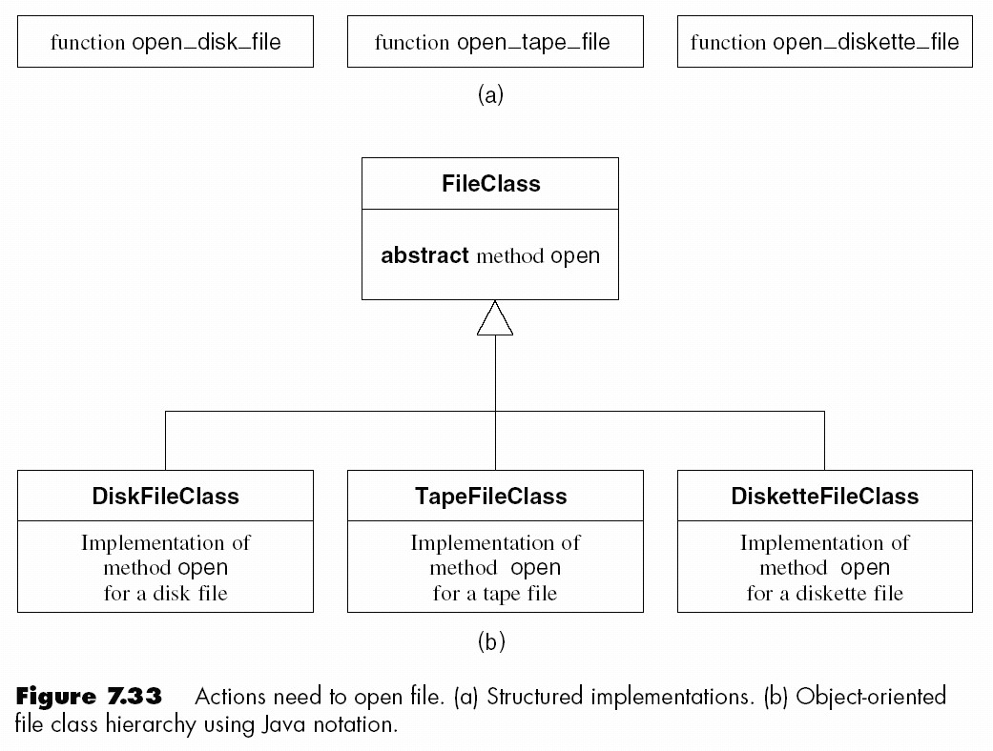
Polymorphism and Dynamic Binding(2 of 4)
Classical paradigm --Must explicitly invoke correct version
Method open can be applied to objects of different classes →Polymorphism
All that is needed is myFile.open() →Correct method invoked at run-time (dynamically)
Method checkOrder (b : Base) can be applied to objects of any subclass of Base

Slide 58
Polymorphism and Dynamic Binding(3 of 4)

Slide 59
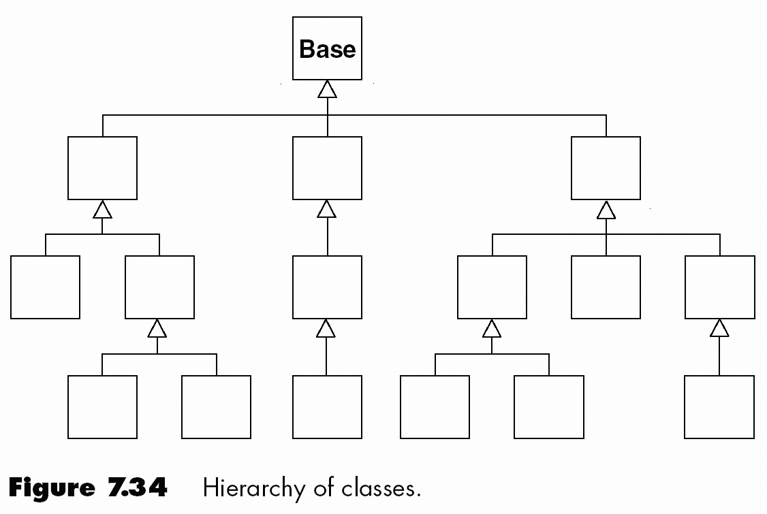
Polymorphism and Dynamic Binding(4 of 4)

Slide 60
組織運作與 object-oriented program (1 of 2)
一個組織中,
  每一個人都有一個職稱(例如程式設計師),且有規定的工作項目(例如撰寫程式、測試程式等等),工作內容可以不同,但工作方式需按職務工作程序的規定執行 →與 object 及 class 的對應關係
  一個工作人員(營業員)可叫另一工作人員(倉庫管理員)執行工作(取貨),且必需告知相關資訊 →message passing
  一個工作人員叫另一工作人員執行工作時,可等待其完成或繼續執行其他工作(multi-thread)

Slide 61
組織運作與 object-oriented program (2 of 2)
  當組織執行其特定任務時(開發軟體),將有一群人依規定順序執行其任務 →OO program執行某一功能
  有一 C程式需撰寫,任一有空的程式設計師均可交付其完成 →polymorphism
  組織中有單位,各單位有其特定功能性,各單位間有一定的協調對象及方式 →subsystem的觀念
需多揣摩組織與OO program的對應關係

Slide 62
Static

Slide 63
Object-oriented program
Main program + classes (+ packages + Interfaces)
Class: name + attributes + methods
Relationship between classes: inheritance, aggregation, (data or control) association
Class diagram:全部、局部
Object diagram: objects 間的關係
問題:
  如何由系統規格產生 class and object

Slide 64
Text
Pressman Appendix B

